Slide 1
Cinema Management System
CMS

Slide 2
List of Group Members
Student ID | Name | Surname
220209402 | Elliot Osazuwame | Oghogho
220209910 | Callistus Chukwuemeka | Udemba
220209342 | Elhaitham Osman Eltahir | Mohamed
220209398 | Ahmad Tijjani | Almajir
210209327 | Mohamed Abdirizak | Ali
210209463 | Niyonizigiye Don | Dief
220209902 | Abdullahi Eniola Yussuff | Oriyomi

Slide 3
Table of Content
Introduction
Database Tables
JDBC implementation
User Interface

Slide 4
Chapter 1: Introduction
Welcome to the world of cinema management systems. This powerful software solution is designed to streamline and automate various aspects of running a cinema or movie theater.
The system performs the following function:
Log in.
Register a new user.
Changing password.
A movie system that contains: Adding/Updating/Deleting/Searching and List of Movies.
A Ticket system that contains: Adding/Updating/ Deleting/Searching and List of Tickets.

Slide 5
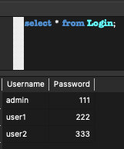
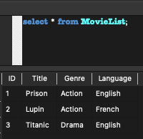
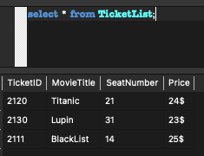
Chapter 2: Database Tables
We have Three Database Table
Login Table
Movie List Table
Ticket List Table

Slide 6
Chapter 3: JDBC implementation
Import all the necessary classes.
Load the JDBC driver.
Establish the Connection
Create a Statement Object
Execute query string using Statement Object
Retrieve data from the returned ResultSet Object

Slide 7
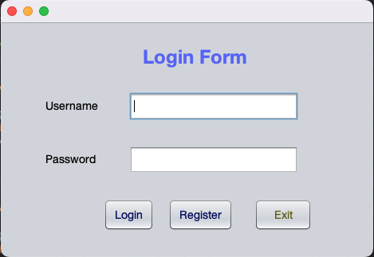
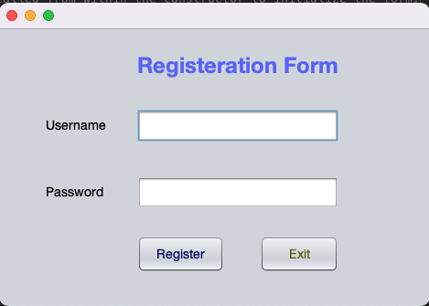
Chapter 4: User Interfaces

Slide 8
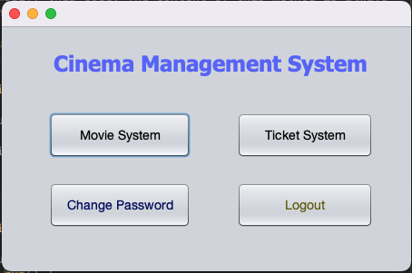
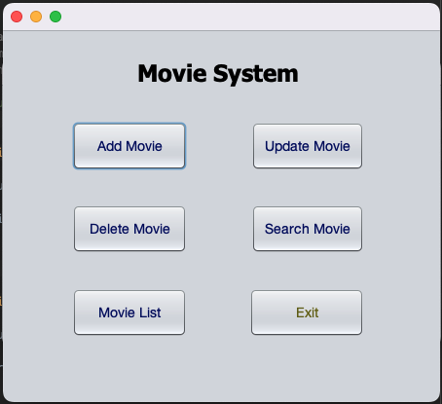
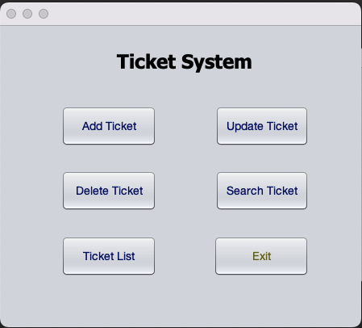
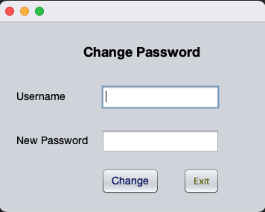
Home

Slide 9
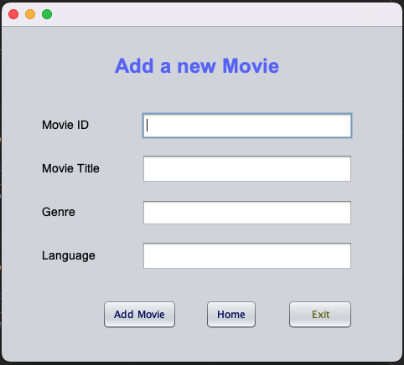
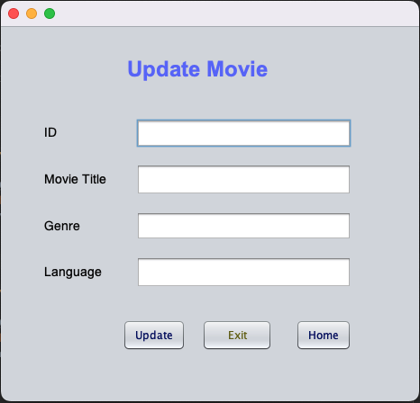
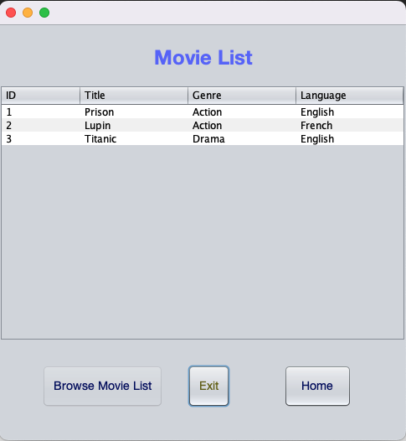
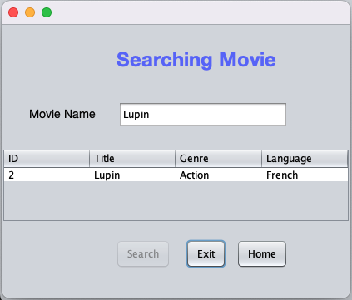
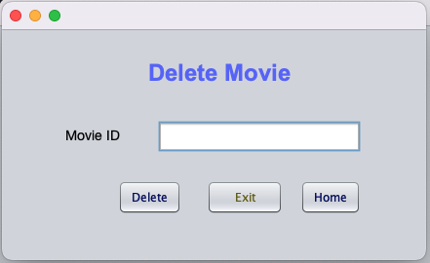
Movie System

Slide 10
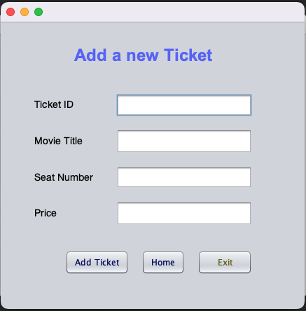
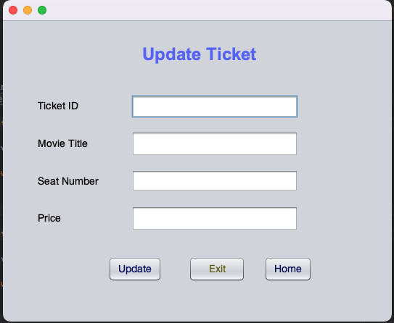
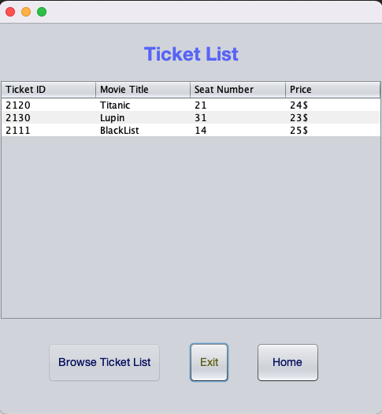
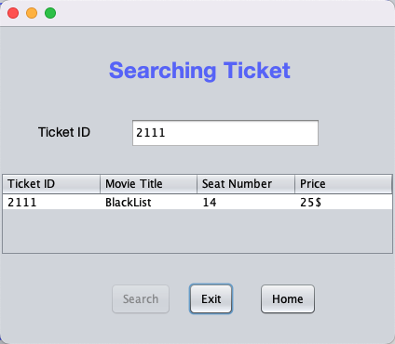
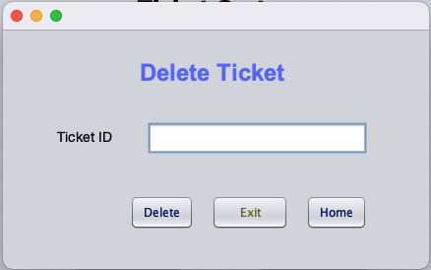
Ticket System

